Slide 1


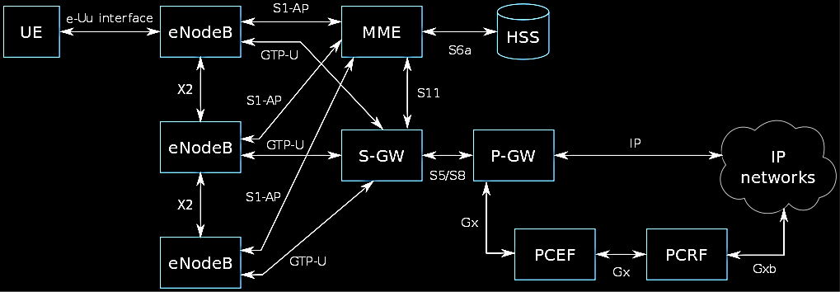
LTE Cat-NB (Narrowband) characterization of UE and MNOs
Daniel Robinson, 2019
Objective
Approach
Conclusion
Application developers and cellular service providers alike are interested in implementing NB-IoT (LTE Cat-NB) as an alternative to LoRaWAN, SigFox and other LPWANs. Application developers require network coverage, and cellular service providers require consumer and enterprise demand or reasonable motivation before rolling it out nationally. Although there is a great deal of theoretical analysis and simulations in research, the lack of empirical evidence may be contributing to the impasse of growth in the network technology. This thesis aims to bridge that divide.
Two mobile network operators (MNOs) are compared in South Africa according to the underlying vendor infrastructure used, namely Nokia and ZTE in the Cape region. Ericsson and Huawei is based in the Gauteng region, and the set of tests devised to compare them aim to highlight striking differences in the underlying complexities of the LTE architecture. More than one UE is used to improve the accuracy of the result
Attenuation does not affect performance as much as the ECL level does, and includes degradation to latency, energy consumption and packet size.
The inefficiency between the two South African MNOs can either be attributed to poor system configuration, or hardware fault. That is, if the network vendor meets the 3GPP's standards. Vodacom’s Nokia infrastructure has failed one of the most important requirements for NB-IoT being under 10 seconds latency for all network conditions. Secondly it is 20dBm RSRP less sensitive than MTN’s ZTE infrastructure, which has satisfactory performance overall. Since the findings are reflected similarly across the Ublox and Quectel UE, it implies that the discrepancies are as a result of the MNO vendor.
Results
Dataset
Power saving and Latency
It is evident that on all attenuation levels there is a high degree of variation in latency and energy, and thus correlation with attenuation is unlikely. Considering the discrepancy between MTN and Vodacom is a ten-fold difference or more, the latter's Nokia towers are vastly inefficient. Lastly, most of the test data falls within the first 10 seconds, with eDRX power saving packets being the most power efficient, and network registration or sending large UDP packets being the least.
The UE reported transmit and receive time is not indicative of the measured latency. Data for both MNOs falls within the first 5 seconds, unlike what was measured.
Current usage is roughly between 70 and 120mA, and skewed towards higher consumption. The UE maintains a max output power of 23 dBm when connected to Vodacom towers, and decreases proportional to RSRP/RSSI on MTN towers. This might be attributable to the ECL level that the eNodeB sets for the UE.
Every UE device and MNO pair (4 total) has 7 main tests and each has its own attenuation zone (5 total). 424 files create a dataset with 1811 trace entries, 40 possible metrics and 79921 values.
Looking at the dataset as a whole this makes 140 unique outcomes (7x4x5). There are 15 subtest types which can be delved into, too.
The dataset is also heavily skewed towards lower latency entries. Tests were repeated with the intent of increasing reliability, especially when it took a couple of seconds, but when a test took 300 seconds it had a much lower chance of being repeated. Also considering that dataset capture may be repeated in different locations, one does not necessarily want to spend more than a day on-site.
To solve for the skewness, each test can be normalized by taking a single mean of each of the associated trace entries and files. Now with a dataset of 140/1811 traces, it makes a minimum of 5600/79921 possible values.
Unfortunately this created problems especially where only a few discrete values are concerned such as in ECL, as multiple means exist. To solve this, K-means clustering is applied.
Instead of finding a single mean for all the entries and associated files, at least two means are specified (K=2) to take into account the outliers that some tests produce or more if discrete values are involved or isolated regions (K=3+).
RF, Packet and Network metrics
RX and TX packets are generally around 100-200 bytes in size. UEs lose signal at -110dBm RSRP for Vodacom, and -130dBm for MTN. SNR is spread relatively evenly for the different attenuation zones, implying that there are other factors besides RF attenuation that affect signal quality. MTN has a low ECL of 0 which keeps energy and latency down, however Vodacom has an ECL of 1 and 2 which increases transmission repetition dramatically.
Absolute maximum of 1811 traces has been reduced/filtered by removing duplicates and applying thresholds. K-means clustering achieves the desired effect of reducing dimensionality and skewness induced from low latency sampling on the dataset for different tests by being close to the single mean, yet keeps most of the features of the filtered set.
Martinez, Borja, Senior Member, IEEE, Ferran Adelantado, Member, IEEE, Andrea Bartoli, and Xavier Vilajosana, Senior Member, IEEE. 2019 “Exploring the Performance Boundaries of NB-IoT.” https://arxiv.org/pdf/1810.00847.pdf
MJ (Thinus) Booysen PhD | PrEng (ZA) | CEng (UK)

